Slide 1

JOGINPALLY.B.R ENGINEERING COLLEGE DEPARTMENT OF COMPUTER SCIENCE ENGINEERING
Gesture Based Communication Using Steganography
PRESENTED BY
G.KRISHNA (22J21A6620)
A.MAHESH KUMAR (22J21A6602)
D MADHU (22J21A6616)
UNDER THE GUIDANCE
MR. G.SANTHOSH KUMAR
ASSISTANT.PROFESSOR

Slide 2
Table of Contents
1.Abstract
2.Title Justification
3.Existing system
4.Limitations
5.Proposed system
6.Advantages
7.Software requirements
8.Hardware requirements

Slide 3
Introduction
With the rapid growth of digital communication, protecting sensitive information has become a major concern. Conventional security methods mainly rely on encryption, which makes data unreadable but still visible to attackers. This visibility often attracts hacking attempts. To overcome these issues, the proposed system introduces gesture-based control along with steganography. By using hand gestures for authentication and hiding data inside media files, the system ensures secure, contactless, and intelligent communication.
4

Slide 4
LITERATURE SURVEY
Review of Video-Based Steganography for Secure Communication
Title | Author | Methodology | Drawbacks | Improvement in Our Project
Data Encryption and Decryption Using Steganography | N. Manohar et al. | Video steganography using LSB, Neural Networks, and Fuzzy Logic with PSNR and MSE evaluation | Uses only steganography, no authentication layer, high computational complexity | Adds gesture-based authentication with steganography to provide dual-layer security

Slide 5
LITERATURE SURVEY
Review of Advanced Video Steganography Methods
Title | Author | Methodology | Drawbacks | Improvement in Our Project
Directional Pixogram: A New Approach for Video Steganography | Mohammed Baziyad et al. | Video steganography using motion vectors and DCT coefficients | High processing cost, suitable only for video, no authentication | Lightweight image-based steganography with gesture authentication

Slide 6
LITERATURE SURVEY
Review of Pixel-Based Image Steganography Algorithms
Title | Author | Methodology | Drawbacks | Improvement in Our Project
A Novel Pixel-Based Steganography Algorithm in Image Hiding | Jawwad A. R. Kazi et al. | Pixel-level embedding of text in images | Single-layer security, vulnerable if algorithm is known | Adds gesture-based verification for secure data extraction

Slide 7
Existing System
In the existing communication systems, most data protection methods depend on encryption and password-based security. Encryption hides the meaning of the message but does not hide the message itself — anyone can see that secret communication is happening. These systems mainly use text-based or key-based authentication, which can be easily targeted by hackers through brute-force or phishing attacks.
Existing secure systems also lack gesture-based controls, which could make the communication more private and hands-free. Since there is no integration of steganography or gesture recognition, the level of security remains limited.
5

Slide 8
Limitations
Only encryption is used, which can still attract attention to the hidden message.
Hackers can identify and try to break encrypted data.
No gesture-based or multi-layer security methods.
Risk of data leakage during transmission.
Not suitable for modern, real-time, or user-friendly communication.
Difficult for common users who are not familiar with complex encryption tools.
6

Slide 9
Proposed System
The system combines gesture recognition and steganography for secure data communication.
Users can use hand gestures instead of typing passwords or commands.
Gestures are used to control the encoding (hiding) and decoding (revealing) of secret information.
The hidden message is stored inside an image or media file using steganography, making it invisible to others.
Only authorized users who know the correct gesture sequence can access or reveal the hidden data.
Two-Layer Protection: First Layer: Gestures act as an authentication key. Second Layer: Steganography hides the actual message inside a media file.
7

Slide 10
Advantages
Dual-layer security (gesture + steganography) makes hacking nearly impossible.
Prevents unauthorized access and data detection.
User-friendly, contactless, and interactive communication.
Reduces risk of brute-force or phishing attacks.
Works with different file formats like images, videos, or audio.
Less data loss, fast processing, and minimal storage usage.
Suitable for modern AI-driven security applications.
8

Slide 11
System Requirement Specification (SRS)
Functional Requirements
The system should detect and recognize user hand gestures.
The system should allow users to hide secret data inside media files.
The system should extract hidden data only after correct gesture authentication.
The system should store and manage user inputs securely.
The system should support image-based steganography.
Non-Functional Requirements
The system should provide high security and reliability.
The response time should be fast and efficient.
The system should be user-friendly and easy to operate.
The system should ensure data privacy and integrity.
The system should be scalable for future enhancements.
8

Slide 12
Software Requirements
Programming Language: Python
• Libraries: OpenCV, NumPy, Matplotlib, Tkinter
• Database: MySQL or SQLite
• IDE: Jupyter Notebook / Visual Studio Code
9

Slide 13
Hardware Requirements
Hardware Requirements:
• System: Intel i5 Processor or above
• RAM: Minimum 4 GB
• Webcam or external camera for gesture detection
• Storage: Minimum 500 MB free space
10

Slide 14
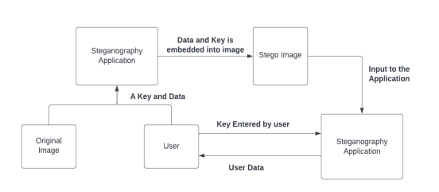
SYSTEM ARCHITECTURE
It allows users to authenticate through hand gestures instead of traditional passwords.
Secret data is hidden inside media files, making it invisible to unauthorized users.

Slide 15
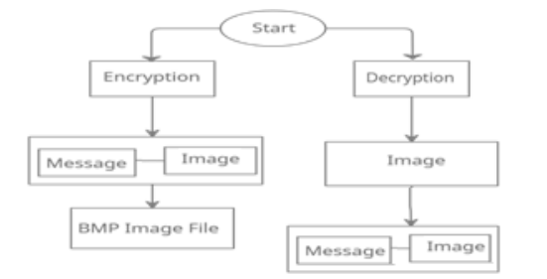
DATAFLOW- DIAGRAMS
The data flow diagram shows how information moves through the system.
User inputs gestures, which are processed for authentication.
Once verified, data is encoded or decoded using steganography within media files.
The system then outputs the secured or retrieved information to the user.

Slide 16
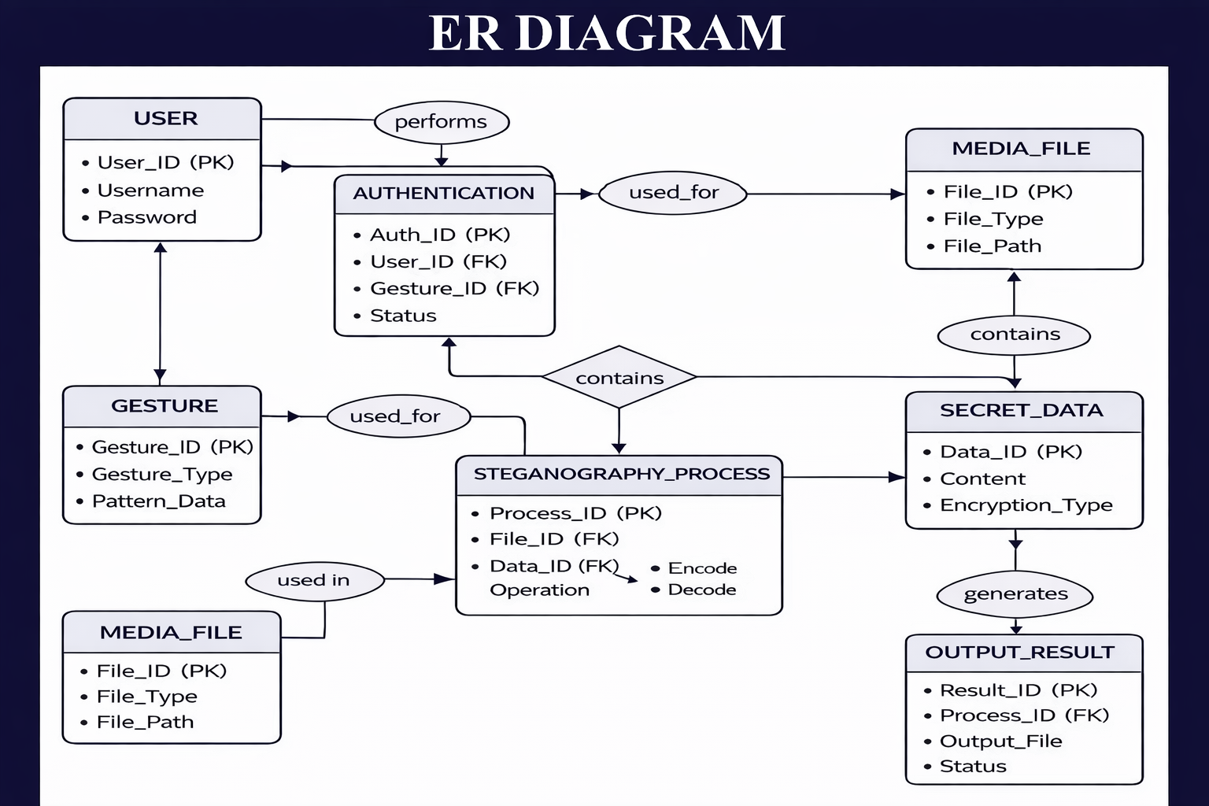
ER- DIAGRAMS
The ER diagram represents the structure of the system and how different components are connected.
It shows entities like User, Gesture, Media File, Secret Data, and Steganography Process.
The relationships explain how users authenticate using gestures and how data is hidden inside media files. Overall, it helps understand how the system securely manages and processes data.

Slide 17
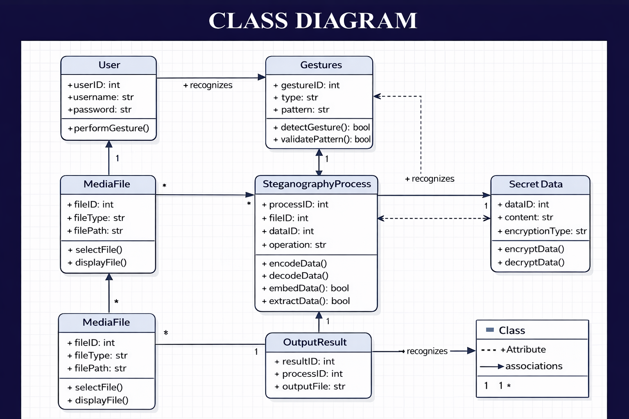
UML DIAGRAMS
CLASS DIAGRAM

Slide 18
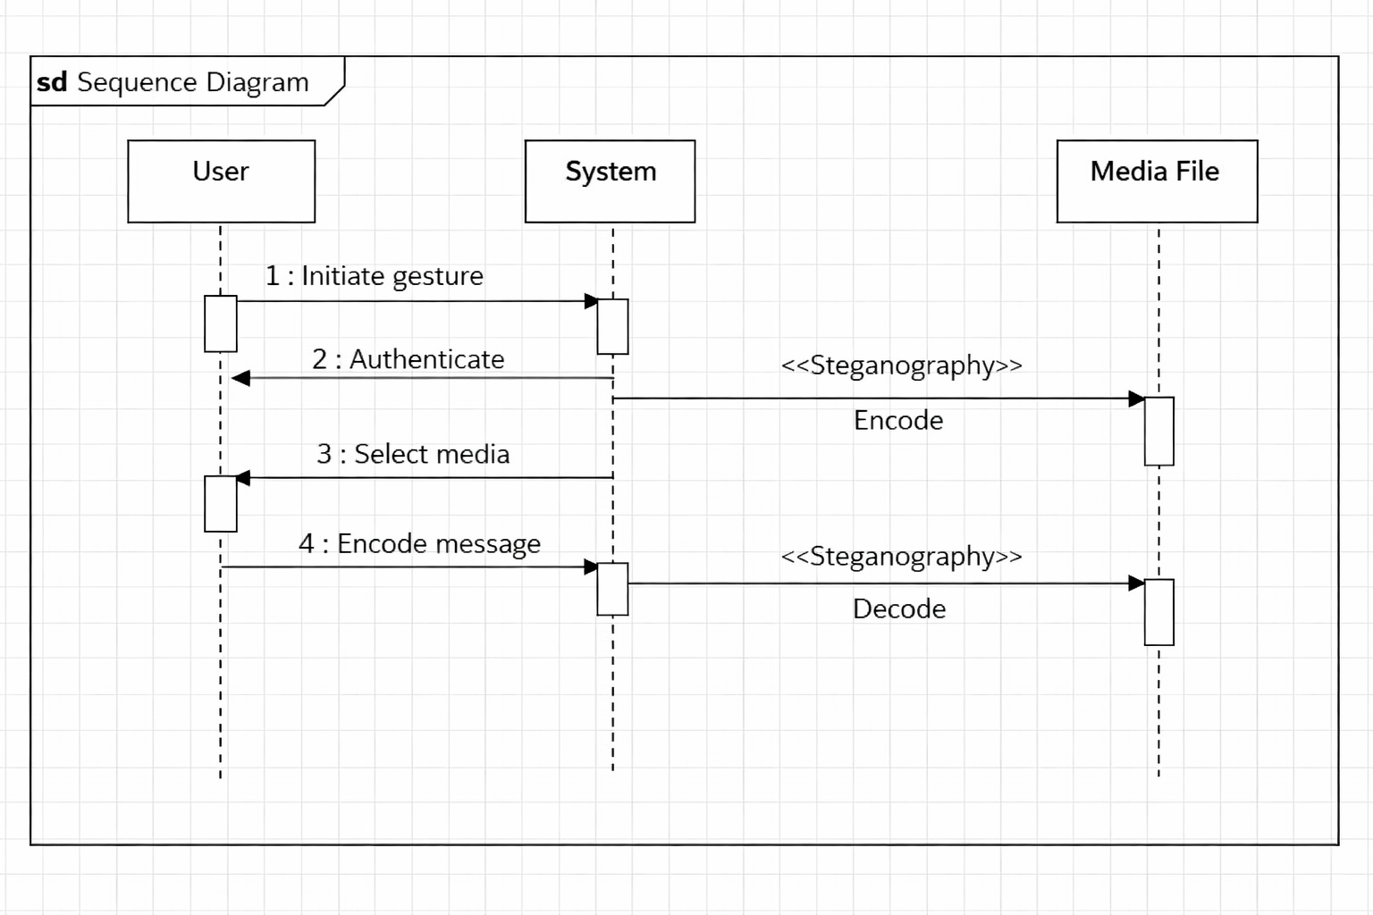
Sequence Diagram

Slide 19
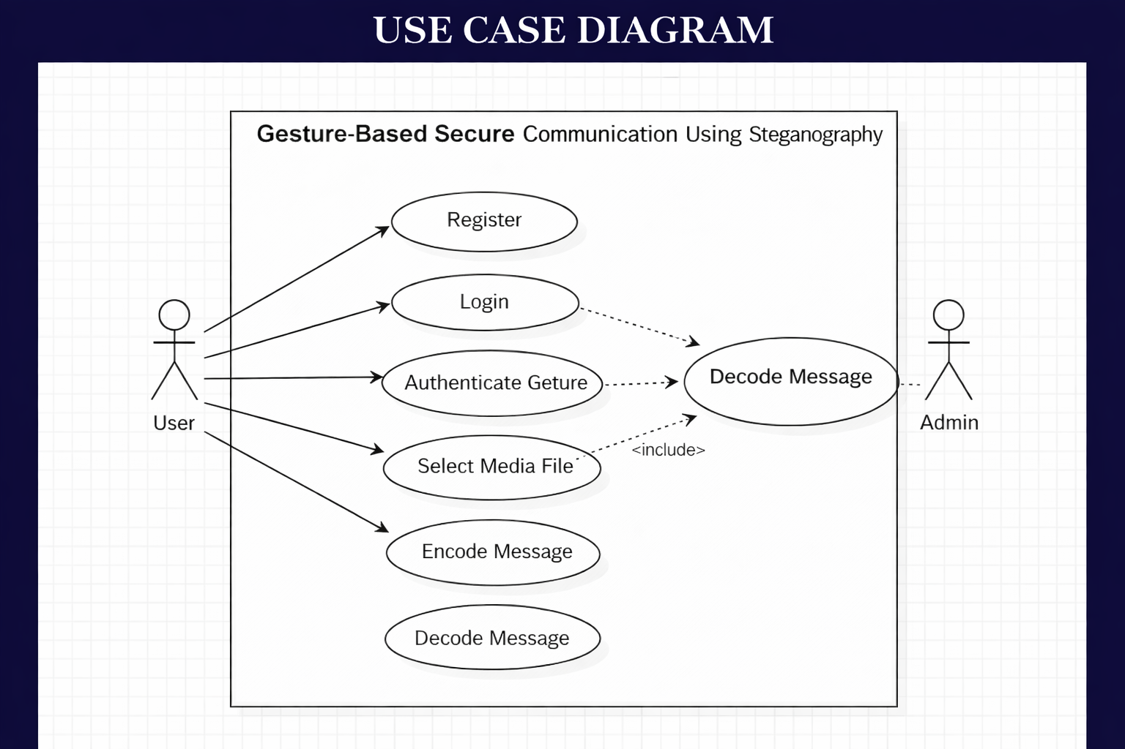
USE CASE Diagram

Slide 20
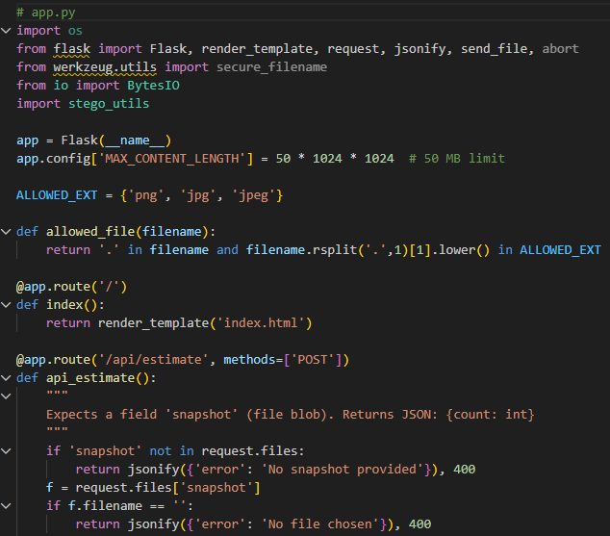
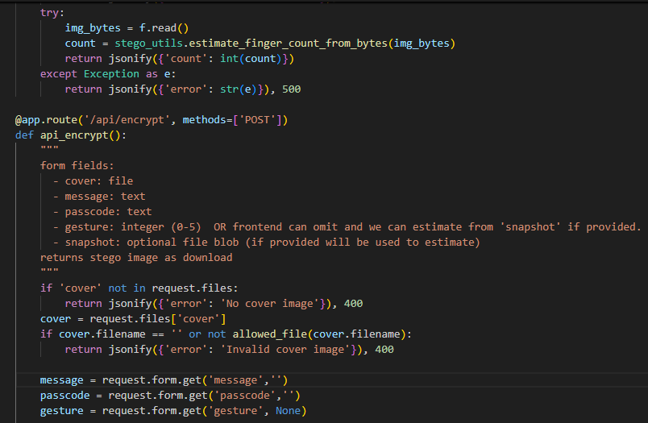
SYSTEM IMPLEMENTATION

Slide 21
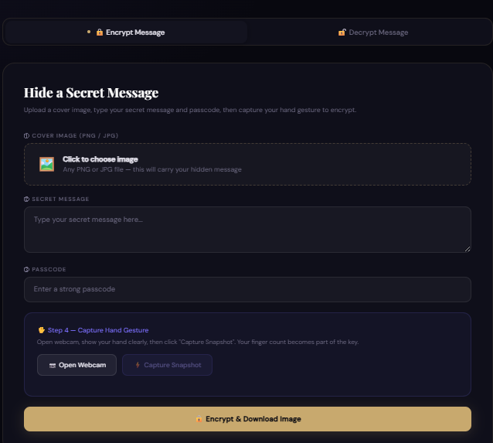
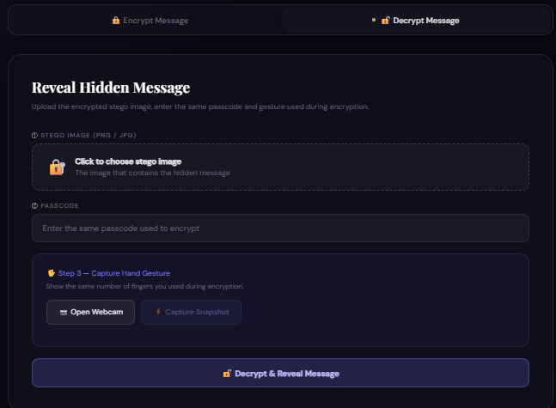
RESULTS / OUTPUT SCREEN

Slide 22
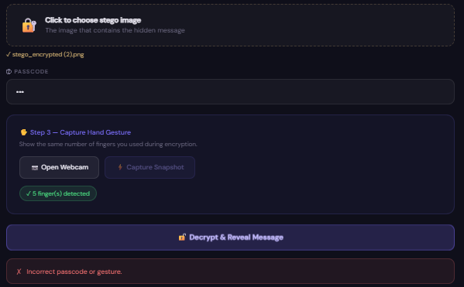
TEST CASES
Even though the gesture was detected, the decryption failed because the entered passcode or gesture does not match the original encryption data.

Slide 23
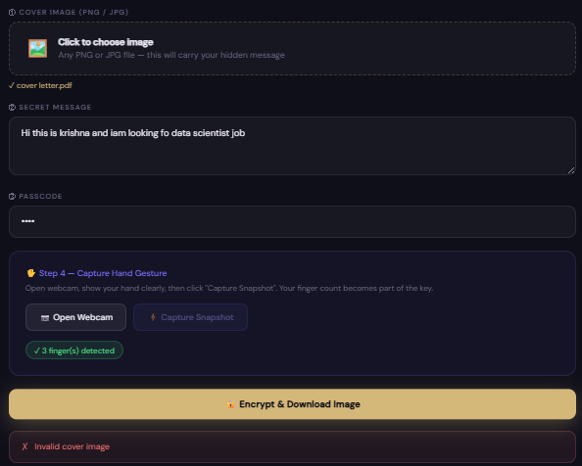
This error can happen if there is an issue with the selected media file.
The system checks whether the uploaded image is valid and contains hidden data.
If the file is incorrect, unsupported, or does not match the original encoded image, decryption will fail.
So, even with the correct gesture, a wrong or mismatched media file can cause the error.

Slide 24
References
1. LSB Steganography
Neil F. Johnson (1998) Sushil Jajodia (1998) Proposed basic image steganography using the LSB technique. Simple and widely used method.
2. Basic Image Steganography
Jessica Fridrich (2001) Worked on practical data hiding techniques in digital images. Focus on simple hiding methods.
3. Text Hiding in Images
Niels Provos (2003) Peter Honeyman (2003) Developed tools for hiding data inside images. Easy concept and suitable for basic implementations.
4. Simple Encryption and Steganography
William Stallings (2005) Explained basic encryption techniques combined with data security. Useful for understanding simple encryption concepts.

Slide 25

The End
THANK YOU FOR LISTENING

